Slide 1

A
capstone project
on:
Xente Fraud Detection
by:
Ajirinsola Oluwafolakemi Ayomide
ayofolakemi01@gmail.com

Slide 2
Introduction
Xente is an e-payments, e-commerce, and financial services company in Uganda where consumers can buy products such as airtime, data bundles, water and electricity bill payments, TV subscription services, event tickets, movie tickets, bus tickets, and more.
Objective: to create a machine learning model to detect fraudulent transactions; this is an important application in the financial services sector.
Importance: This solution will help Xente provide improved and safer
service to its customers.

Slide 3
Problem Statement
Detecting fraudulent transactions is a critical challenge in the financial services sector, where timely and accurate identification of fraudulent activities is essential to protect consumers and businesses.
Xente, an e-payments, e-commerce, and financial services company in Uganda, aims to enhance its security measures by developing a machine learning model to detect fraudulent transactions.

Slide 4
Methodology
Lorem 2
Data Cleaning
Data Cleaning
Lorem 3
EDA
Lorem 4
Data Preprocessing
EDA
Lorem 1
Machine learning
Data Inspection
Data Inspection
Important library were imported
The dataset was imported
The data was inspected by checking:
The shape
The info
Descriptive analysis
Missing value
There was no missing value
The columns were changed to the correct data type
The irrelevant columns were dropped
The library used were seaborn and matplotlib.
Barchart showing the target count before and after balancing were plotted.
Univariate EDA on Numerical variables were plotted
EDA on some categorical variables were plotted

Slide 5
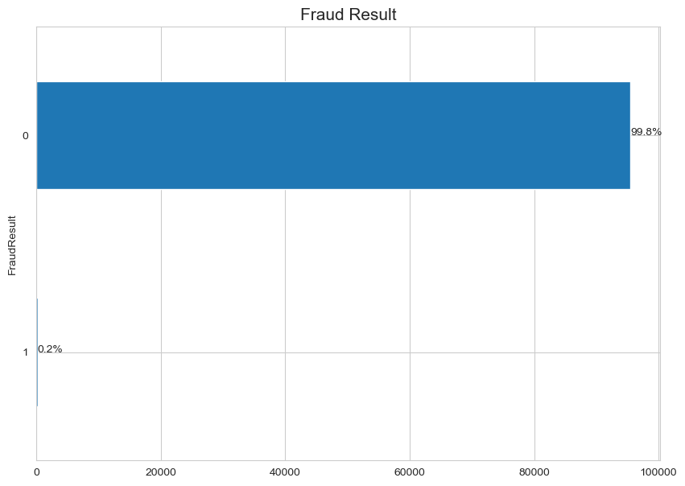
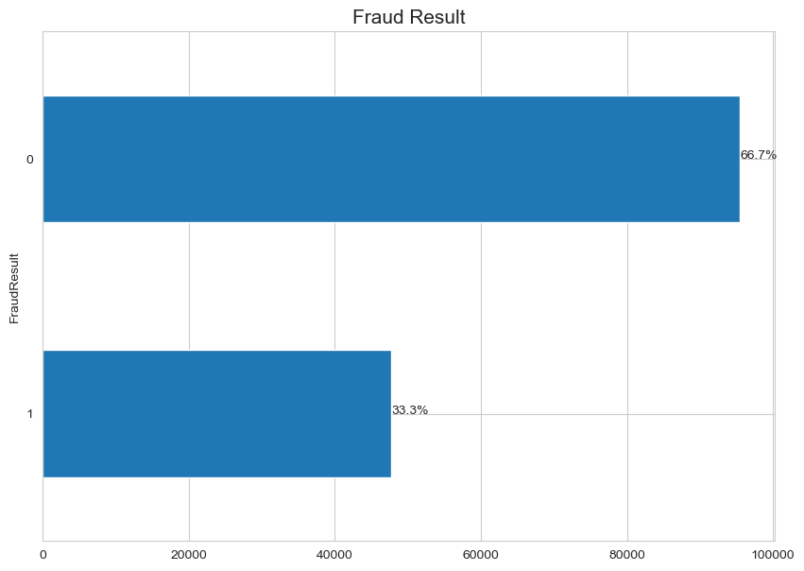
Exploratory data analysis (EDA)
a) Fraud result count before balancing
b) Fraud result count after balancing

Slide 6
Methodology
Data Preprocessing
Lorem 1
Data Inspection
SMOTE was used to balance the data set using sampling strategy of 0.5
This was used to avoid over populating the dataset as well as over reducing the data set
One hot encoding was used to code the categorical variables into numbers; this helps the machine the understand the dataset.
Min max scaler was used to scale the dataset

Slide 7
Methodology
Machine learning
Lorem 4
Machine learning
Lorem 1
Data Inspection
Pre-model selection:
Data set was splitted into x test, x train, y test and y train.
X train and y train was fitted into the model
Model selection:
The model selected were: Random Forest Classifier and decision tree classifier.
These models were selected because it is a classification task.

Slide 8
Model Evaluation
Random Forest Classifier :
Random Forest Model accuracy score: 99.3529
Random Forest Model precision score: 98.0895
Random Forest Model recall score: 99.9930
Random Forest Model f1 score: 99.0321
Decision Tree Classifier:
Decision Tree Classifier accuracy score: 99.3436
Decision Tree Classifier precision score: 98.0625
Decision Tree Classifier recall score: 99.9930
Decision Tree Classifier f1 score: 99.0183

Slide 9
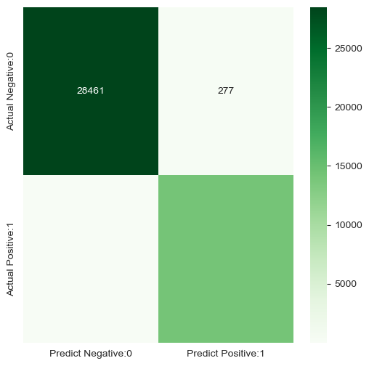
Discussion
Result
Random Forest Classifier :
True positive (TP) = 14222
True negative (TN) = 28461
False positive (FP) = 277
False negative (FN) = 1

Slide 10
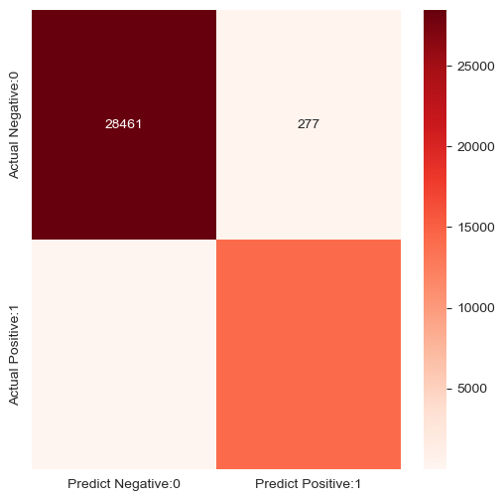
Result
Discussion
Decision Tree Classifier :
True positive (TP) = 14222
True negative (TN) = 28457
False positive (FP) = 281
False negative (FN) = 1

Slide 11
Conclusion
Random Forest classifier model is the preferred model

Slide 12



Thank you for listening.

